Slide 1
Going Live
Lesson 2.1

Slide 2
Objectives
In today’s class, we will:
Recap the basic topics covered to date.
Offer a conceptual introduction to CSS reset and downloadable style sheets.
Work with Chrome DevTools for site inspection.
Utilize GitHub Pages for website deployment.
Notes:
6:30-6:31 (1 min)

Slide 3

Checking In
How’s it going?
Going Live
Notes:
6:31-6:33 (2 min)
shutterstock_411452953

Slide 4

Instructor Feedback
Notes:
6:33-6:36 (3 min)
Start with asking the room for a few minutes
6:36-6:39 (3 min)
Send out slack feedback poll

Slide 5
Student Feedback
Things I’ve noticed people doing incredibly well:
You all help each other out.
Amazing intuition. All of you are asking the right questions.
You notice the right details.
All of you are handling an enormous volume of information.
You are figuring out things on your own.
Notes:
6:39-6:41 (2 min)
We are really here to teach you how to learn

Slide 6
A Few Admin Things

Slide 7
Homework
Remember, Homework 1 is due on 11/23
Homework link: https://uwa.bootcampcontent.com/UWA-Bootcamp/UW-SEA-FSF-PT-11-2019-U-C/tree/master/01-Week_HTML-CSS/HW
Remember to submit homework via GitHub and BootcampSpot
And seriously, submit whatever you have, even if you don’t like what you’ve made. Not submitting your assignment will result in a 0.
Notes:
6:41-6:42 (1 min)
This isn’t high school where you can wait until the day before it’s due
If you try to complete a 20 hour HW the day before it’s due you’re not going to have a good time
Trust me, in this course there will be many instances in which you don't feel like your homework is fully complete. You may have unresolved bugs. Your design may not have turned out quite right. You may not have had as much time as you would have liked to work on the assignment. But here's the thing: submit anyway. It's important that as a developer you get used to imperfection. And the only way we can help you is if we know where you're at.

Slide 8
Recap

Slide 9

Recap
In just one whirlwind of a week we’ve covered:
Basics of full-stack development
Terminal and Git Bash
HTML syntax
Git concepts and commands
GitLab and GitHub
CSS purpose, syntax, and styles
Box model
Flexbox
Positioning and displaying elements
Chrome DevTools
How to learn on your own!
Notes:
6:43-6:45 (2 min)

Slide 10

What Is Full-Stack Development?
Notes:
6:45-6:46 (1 min)

Slide 11
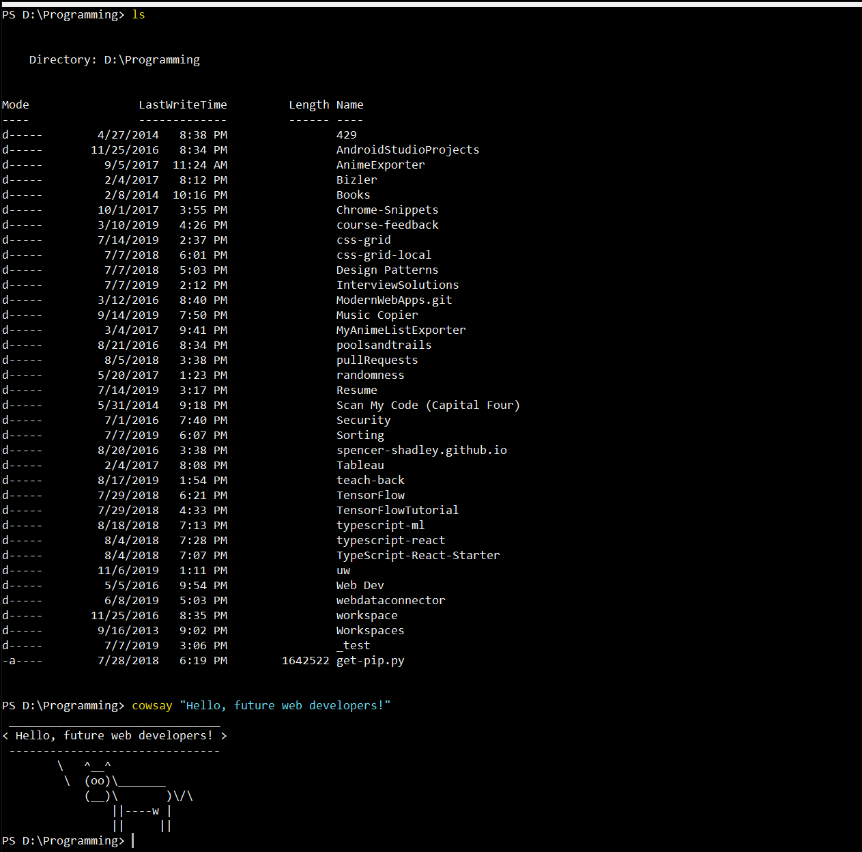
> Intro to Console
Notes:
6:46-6:47 (1 min)

Slide 12
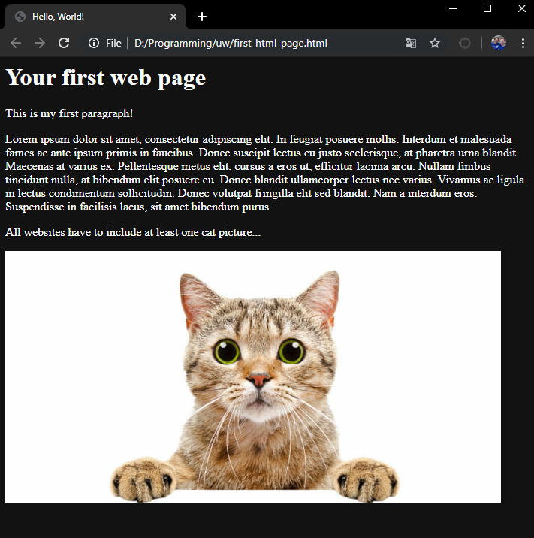

<title> Intro to HTML </title>
HTML is one of the three base languages behind every website.
It defines all of the basic content as well as a bit of formatting.
Notes:
6:47-6:48 (1 min)

Slide 13





Pushing and Pulling with Git
1
2
3
4
Git Branch
Pull Code
Push Code
Pull Code
Push Code
Pull Code
Push Code
Notes:
6:48-6:49 (1 min)
Anyone know what the thing on the top left is?
Ask: Why is git (VCS in general) important?

Slide 14
CSS Syntax
CSS works by hooking onto selectors added into HTML using classes and identifiers.
Once hooked, we apply styles to those HTML elements using CSS.
selector
property
value
declaration end
a
{
background-color
:
yellow
;
}
declaration start
property/value separator
declaration separator
Notes:
6:49-6:50 (1 min)

Slide 15
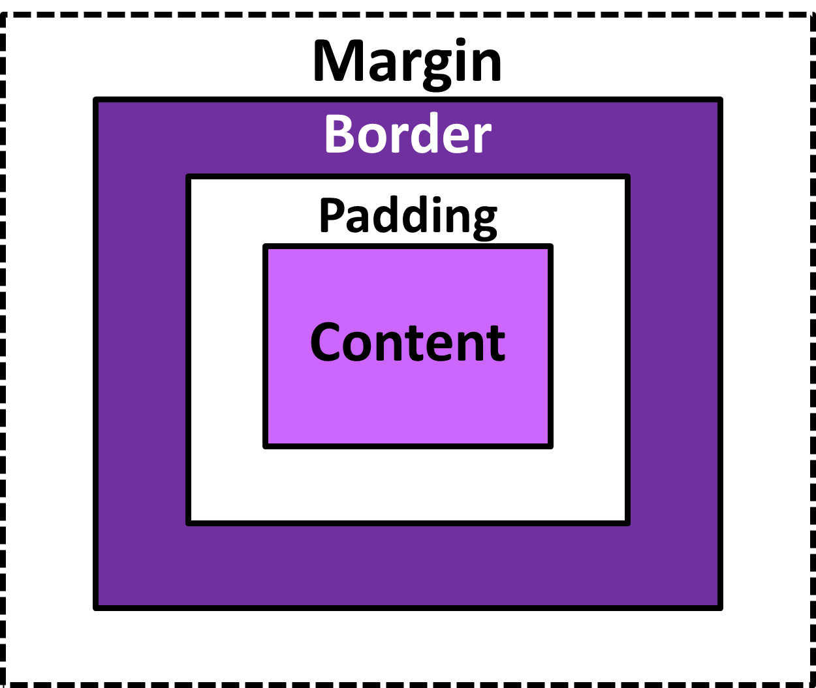
The Box Model
The CSS box model wraps every HTML element in a box. This box consists of padding, border, margin, and content, and allows developers to modify spacing styles.
Notes:
6:50-6:51 (1 min)

Slide 16

Flexbox
How to layout items using flexbox.
Notes:
6:51-6:52 (1 min)

Slide 17
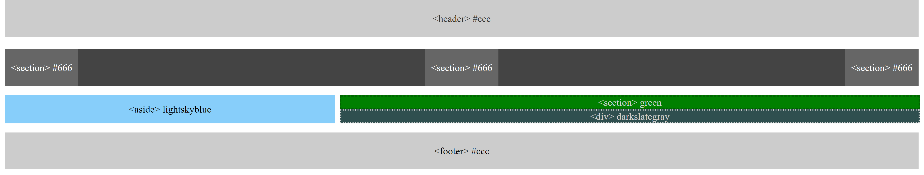
Advanced Layouts
Combining your HTML, CSS and flexbox knowledge to create an advanced layout
Notes:
6:52-6:53 (1 min)

Slide 18

CSS Positioning
We can orient our HTML elements in relation to space with CSS positioning (static, relative, fixed and absolute)
Notes:
6:53-6:54 (1 min)

Slide 19
Resources
Added resources directory to GitLab
Class resources
Documentation
Help
Interesting Reads
Tutorials
Notes:
6:54-6:56 (2 min)

Slide 20
Any Questions/Concerns/Issues?
Notes:
6:56-6:57 (1 min)

Slide 21
Double Take

Slide 22
Divs and Sections
What is the difference between <section> and <div>?
What is the purpose of new HTML5 elements like <section> and <article>?
Why would you use an HTML5 semantic tag instead of <div>?
When do you use a <div> element, and when do you use a <section> element?
Which should you use for semantic markup and page layout: <section> or <div>?
Notes:
6:57-6:58 (1 min)
TAs: slack out container types - https://www.w3schools.com/html/html5_semantic_elements.asp
Maybe add to resources in GitLab
Section is grouped content (single cohesive theme like the content within a tab)
General rule: only use section if you would include that in an index/outline for the document
Article is self-contained content. This would stand and make sense on its own.
div has no direct semantic meaning, just a container – last resort

Slide 23
Divs and Sections
All web layouts are made up of containers, traditionally called divs.
Page
Header
Content
Entry | Sidebar
Entry
Entry
Footer
Notes:
6:58-6:59 (1 min)

Slide 24
Divs and Sections
HTML5 introduced the concept of semantic layouts, meaning divs could be given more meaningful names. In theory, this helps with organization and search engine optimization.
Website Layout Using HTML5: HTML5 offers new semantic elements that define different parts of a webpage:
<header>
<nav>
<section> | <aside>
<article>
<footer>
<header> | Defines a header for a document or a section
<nav> | Defines a container for navigation links
<section> | Defines a section in a document
<article> | Defines an independent self-contained article
<footer> | Defines a footer for a document or a section
<details> | Defines additional details
<summary> | Defines a heading for the <details> element
Notes:
6:59-7:00 (1 min)

Slide 25
Divs and Sections
That said, it seems many, if not most, websites still use basic divs.
There are reasons for this that we’ll showcase in later lessons.
Additionally, it’s possible to include semantics by using ID names and classes.
<header>
<nav>
<section> | <aside>
<article>
<footer>
Notes:
7:00-7:01 (1 min)

Slide 26
Divs and Sections
Bottom line: Follow the homework instructions. And when you’re out in the real world, follow the convention of where you work!
div?
section?
Notes:
7:01-7:02 (1 min)

Slide 27

Classes vs. IDs
When choosing between a CSS ID and a CSS class, follow the convention:
Classes (.classname) are used if the same style will be used on multiple HTML elements.
IDs (#idname) are used if a style is unique to a certain HTML element.
Notes:
7:02-7:03 (1 min)
Class is a “class” or “collection” of related items
shutterstock_773920963

Slide 28
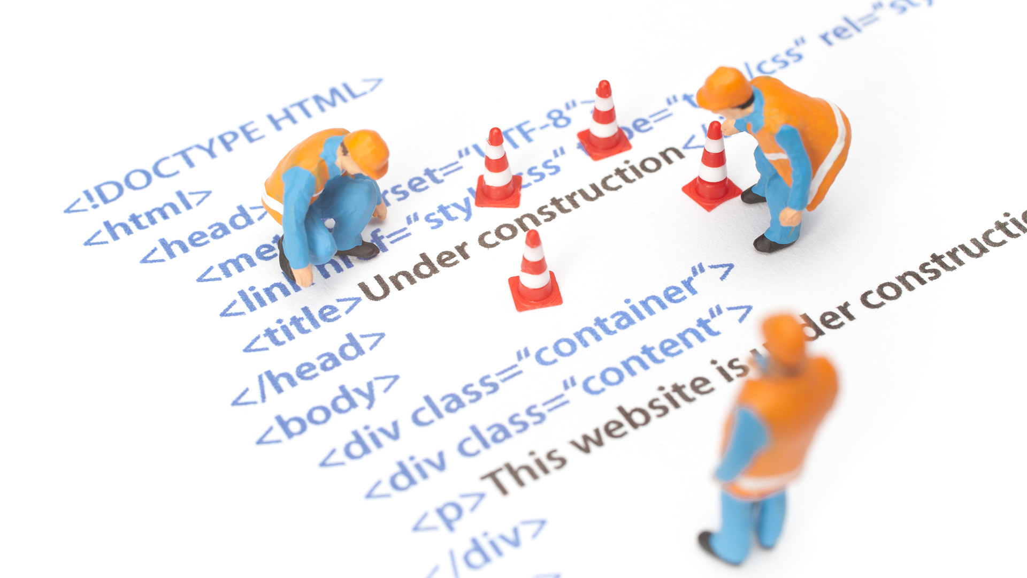
Chrome DevTools (Inspector)
This is one of the web development tools you will use most frequently. It allows you to investigate how and why HTML is rendering.
Start using it!
Notes:
7:02-7:03 (1 min)
shutterstock_117393862

Slide 29
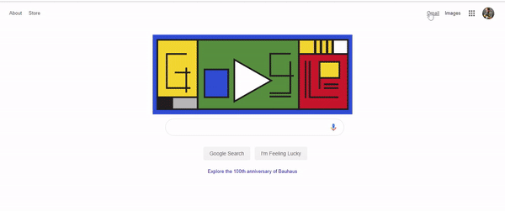
Modifying Sites
You can edit any page’s HTML and CSS with Chrome DevTools.
Plus, you’ll see your results instantly.
Notes:
7:03-7:04
shutterstock_1125750473

Slide 30
Chrome DevTools
Notes:
7:03-7:13 (10 min)
Everyone do this with me
https://www.forbes.com/billionaires/#213aeaea251c
Point out that the “Elements” tab is what matters right now
Breakdown of “Element”, “Styles” and “Console”
Show how to edit, move and delete HTML (Bill is actually richest again)
Show CSS rules
Show computed rules
Replace my name as richest
Add LinkedIn picture
30

Slide 31
Activity: Modify a Website
For the next 15 minutes, take a website you commonly use (Amazon, Google, Tableau, etc.) and heavily modify it using Chrome DevTools.
Be sure to modify the following:
Content (change words)
Colors
Spacing
Send a screenshot to the class’s Slack channel when you’re done.
Windows: windows+shift+S
Mac: command+shift+5
Notes:
7:13-7:28 (15 min)
7:28-7:30 (show off some students)

Slide 32

Practice Through Frustration
Keep practicing. It gets better!
Notes:
730-
shutterstock_360676460

Slide 33
Activity: Modify Your Own Website
For the next 10 minutes, edit any site that you’ve been working on—in class or for homework—with Chrome DevTools.
Be sure to at least modify:
Content (change words)
Colors
Spacing
Notes:
730-740

Slide 35
CSS Resets
Notes:
740-55 (BREAK!)

Slide 36


Loading Multiple CSS Files (Important!)
Deploying multiple CSS files simultaneously is a powerful technique.
This technique allows developers to create complex designs made up of abounding design elements.
Remember, the loading order matters!
Notes:
755-56 (1 min)

Slide 37
Multiple CSS Files
Notes:
756-806
Mention live server extension
Mention auto-format
Mac and Windows: alt+shift+f
Use 03-MultipleCSS/index.html
Create <link rel=“stylesheet” href=“first-loaded.css”
Two more
Start with li color
ul background color
li color again (overwrite)
Ask: (Khangai) Why would we want to have multiple CSS files in one place? Why not just all in one?
1-3_CSSFiles.html | 3-MultipleCSS
37

Slide 38
By a show of hands,
which browser do you use?

Slide 39

Reset.css (or Normalize.css)
Reset.css will “reset” all browser-specific CSS. This means your site will appear the same in all browsers.
However, you will have to restyle everything yourself.
Notes:
806-808
Controversial
They provide a blank canvas; any styles applied are (almost) certain to be your own.
Development can be more logical: you’re adding styles rather than removing or modifying them.
Browser compatibility issues can be minimized.
Issues
Performance (pulling down ~2KB of code)
Requires more work to restyle everything
Isn’t perfect for browser compatibility

Slide 40
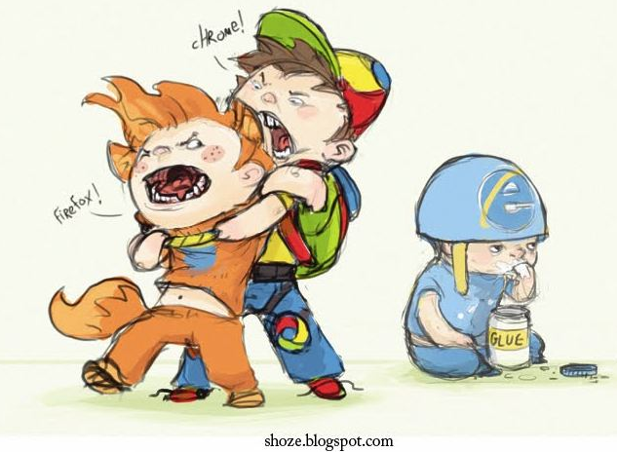
Battle of the Browsers
Under the hood, web browsers often render webpages differently than their competition.
These disparities could mean that the HTML/CSS displays differently in each web client.
Because of these potential differences, web developers need to make their websites cross-browser compatible.
Notes:
808-10 (2 min)
Every browser uses their own secret stylesheet
Blue for unvisited links, purple for visited ones
Bold for strong tags
Large text for h1
Display: none for head!
https://codepen.io/MartijnCuppens/pen/MXojmw
Chromium list
https://chromium.googlesource.com/chromium/blink/+/master/Source/core/css/html.css
Firefox
https://dxr.mozilla.org/mozilla-central/source/layout/style/res/html.css

Slide 41
CSS Resets
Notes:
810-820
Open instructor-browser-diff.html
Google “normalize.css”
Example.html | 4-ResetCSS
41

Slide 42
Why CSS Resets Matter
01
They are important for creating browser-compatible websites.
02
They are an example of using someone else’s CSS in your website.
03
They might be asked in front-end developer interview questions.
Notes:
820-821

Slide 43
Activity:
CSS Resets
Notes:
821-831

Slide 44
Activity: CSS Resets
Follow the instructions provided via Slack to incorporate a reset.css file into a basic HTML file.
Note the impact the reset file makes after its inclusion.
Notes:
821-31

Slide 45
To the Web with GitHub!
Notes:
831-32

Slide 46


The Internet
Here is a deep and complex diagram illustrating how the internet works.
The internet
Notes:
832-33

Slide 47
The World Will See Our Greatness!
GitHub provides hosting for static websites, which means we can deploy our websites and applications onto their servers for the world to see.
Notes:
833-35
Demo my personal website

Slide 48
Let’s All Log In to GitHub
Notes:
835-836

Slide 49
GitHub Pages Deployment—Personal
Notes:
836-46
Somewhere has to “host” our site
We “deploy” this site onto a “host”
We can take our GitHub code and turn them into live webpages without having to worry about another host
GitHub Pages allows you to create two different types of sites (we will be going over both methods):
Personal/organization sites for your account
Sites that are specific to a project/repository
uw-bootcamp
49

Slide 50
Activity: Deploying Bio to GitHub Pages
Time to take your newfangled website and deploy it to the cloud—in this case, GitHub Pages.
Additional instructions will be sent via Slack.
Notes:
846-901

Slide 51
Deploying a Static Personal Site to GitHub Pages
Follow these basic steps:
Create a new repo named _username_.github.io.
Navigate to a folder on your computer and clone the repo into it.
Build your files.
Add, commit, and push your changes to the repository.
Notes:
846-901

Slide 52
GitHub Pages Deployment—Project
Notes:
901-912
52

Slide 53
Activity: Creating a Project Site
Build a newfangled website, and then deploy it to GitHub Pages as a project instead of a personal site.
Additional instructions will be sent via Slack.
Notes:
912-927

Slide 54
Deploying a Static Project Site to GitHub Pages
Follow these steps:
Create a new repository in your GitHub account. You can name this repository whatever you like.
In the repository, create a new file and name it index.html.
Add some basic HTML to this file, save it, and then navigate to your repository’s Settings tab.
Scroll down to the GitHub Pages section. In the Source section, select the master branch as your source
Navigate to <username>.github.io/<repositoryname>; you will find that your new webpage has gone live!
Notes:
912-927

Slide 55
Questions?
Notes:
927-930
Help on HW or anything else

